Slide 1
Computer Architecture I
CS-GY-6133
Topic: Single Cycle MIPS Implementation
Instructor: Siddharth Garg

Slide 2
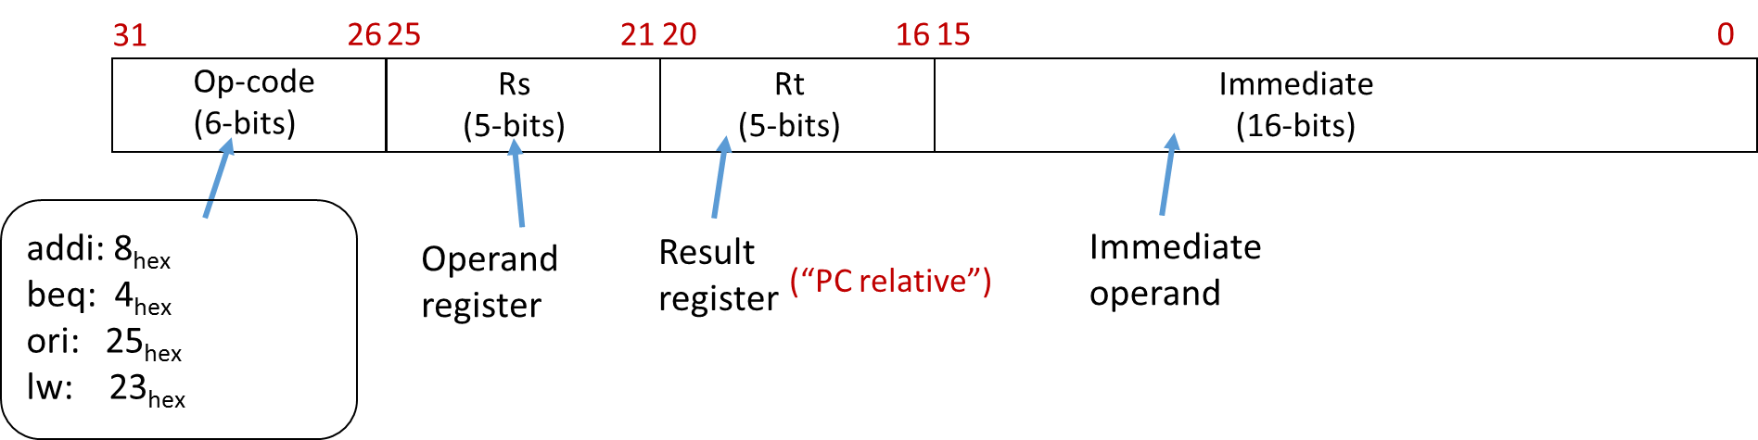
I-Type Load
Instructions
ALUOp = ?
25:21
3
Rd Reg. 1
Read
Data 1
Read Mem
Instruction
20:16
Rd Reg. 2
Instruction Fetch Part Not Shown
ALU
result
Address
15:11
Wrt Reg.
Read
Data 2
Wrt Data
I-Type?
Write
Data
Wrt Enable
Read Data
1
I-Type?
15:0
Sign
Extend
Data Memory
Write Mem

Slide 3
I-Type Load
Instructions
ALUOp = 001
25:21
3
IsLoad?
Rd Reg. 1
Read
Data 1
Read Mem
Instruction
20:16
Rd Reg. 2
ALU
result
Address
Instruction Fetch Part Not Shown
Wrt Reg.
Read
Data 2
15:11
Wrt Data
I-Type?
Write
Data
Wrt Enable
Read Data
1
I-Type?
15:0
Sign
Extend
Data Memory
Write Mem
0
IsLoad?

Slide 4
I-Type Store Instructions
sw rs, rt, imm //M[R[rs]+SignExtendimm] ← R[rt]
ALUOp = 001
25:21
3
isLoad?
Rd Reg. 1
Read
Data 1
Read Mem
Instruction
20:16
Rd Reg. 2
ALU
result
Address
Instruction Fetch Part Not Shown
Wrt Reg.
Read
Data 2
15:11
Wrt Data
I-Type?
Write
Data
Wrt Enable
Read Data
0
1
I-Type?
15:0
Sign
Extend
Data Memory
Write Mem
isStore?
In-Class Problem 2:
Did we miss something?
IsLoad?

Slide 5
Final Data-Path
(Excluding Control Flow Instructions)
ALUOp = 001
25:21
3
isLoad?
Rd Reg. 1
Read
Data 1
Read Mem
Instruction
20:16
Rd Reg. 2
ALU
result
Address
Instruction Fetch Part Not Shown
Wrt Reg.
Read
Data 2
15:11
Wrt Data
I-Type?
Write
Data
Wrt Enable
Read Data
!(IsStore?)
I-Type?
15:0
Sign
Extend
Data Memory
Write Mem
isStore?
IsLoad?

Slide 6
MIPS Instructions: J-Type
31
26
25
0
Op-code
(6-bits)
address
(26-bits)
j: 2_{hex}
jal: 3_{hex}
Immediate operand
j address // PC ← {PC+4[31:28], address, 00}

Slide 7
Control Flow
J-Type Control Flow
4 MSB bits taken from the 4 MSBs of PC+4
Next 26 bits taken from the “address” field
Last 2 bits are set to zero? (why?)
31
26
25
0
Op-code
(6-bits)
address
(26-bits)
j address // PC ← {PC+4[31:28], address, 00}, opcode=2_{hex}

Slide 8
J-Type Control Instruction
J-Type?
31:28
Concat
PC+4
00
Adder
+4
25:21
RF Onwards Not Shown
Rd Reg. 1
Read
Data 1
25:0
20:16
Rd Reg. 2
PC
Read Address
15:11
Wrt Reg.
Read
Data 2
Wrt Data
Instruction
I-Type?
Instruction Memory
Wrt Enable
What about WrtEnable?
!(J-Type?)
!(IsStore?)
0
15:0

Slide 9
Control Flow
I-Type Branch Instruction
First 30 MSBs from sign extended immediate
2 LSBs are always 0
31
26
25
21
20
16
15
0
Op-code
(6-bits)
Rs
(5-bits)
Rt
(5-bits)
Immediate
(16-bits)
beq rs, rt, imm // If (R[rs]==R[rt])
// PC ← PC + 4 + {SignExtendImm, 00},
// else
// PC ← PC + 4
// opcode=4_{hex}

Slide 10
NextPC? = function(J-Type?, IsBranch?, IsEq?)
3:1 MUX
PC+4
31:28
Adder
Concat
{SignExtendImm[29:0],00}
PC+4
00
Adder
+4
29:0
25:0
25:21
Rd Reg. 1
Read
Data 1
IsEq?
20:16
=
PC
Rd Reg. 2
Read Address
15:11
Wrt Reg.
Read
Data 2
Instruction
Wrt Data
Instruction Memory
I-Type?
Wrt Enable
!(IsBranch?)
I-Type?
15:0
Sign
Extend

Slide 11
IsLoad?
Generating Control Signals
(Control Path)
IsStore?
Decoder
I-Type?
ALUOp
Wrt Enable
ALUOp
25:21
3
isLoad?
Rd Reg. 1
Read
Data 1
Read Mem
Instruction
Inst[31:0]
20:16
Rd Reg. 2
ALU
result
Address
Instruction Fetch Part Not Shown
Wrt Reg.
Read
Data 2
15:11
Wrt Data
I-Type?
Write
Data
Wrt Enable
Read Data
I-Type?
15:0
Sign
Extend
Data Memory
Write Mem
isStore?
IsLoad?

Slide 12
IsLoad? = (Inst[31:26] == 100011)
IsStore? = (Inst[31:26] == 101011)
Decoder
I-Type? = (Inst[31:26] != 00000) && (Inst[31:26] != 00010)
ALUOp
Wrt Enable
ALUOp
25:21
3
isLoad?
Rd Reg. 1
Read
Data 1
Read Mem
Instruction
Inst[31:0]
20:16
Rd Reg. 2
ALU
result
Address
Instruction Fetch Part Not Shown
Wrt Reg.
Read
Data 2
15:11
Wrt Data
I-Type?
Write
Data
Wrt Enable
Read Data
I-Type?
15:0
Sign
Extend
Data Memory
Write Mem
isStore?
Control Path
IsLoad?

Slide 13
If (Inst[31:26] == 100011) | (Inst[31:26] == 101011)
ALUop = 001
Else
ALUop = Inst[2:0]
Decoder
ALUOp
Does this cover all cases?
ALUOp
25:21
3
isLoad?
Rd Reg. 1
Read
Data 1
Read Mem
Instruction
Inst[31:0]
20:16
Rd Reg. 2
ALU
result
Address
Instruction Fetch Part Not Shown
Wrt Reg.
Read
Data 2
15:11
Wrt Data
I-Type?
Write
Data
Wrt Enable
Read Data
I-Type?
15:0
Sign
Extend
Data Memory
Write Mem
isStore?
Control Path
IsLoad?

Slide 14
If (Inst[31:26] == 100011) | (Inst[31:26] == 101011)
ALUop = 001
Else If (Inst[31:26]==000000)
ALUop = Inst[2:0]
Else
ALUop = Inst[28:26]
Final Correct Implementation of ALU OP
Instruction Fetch Part Not Shown
Control Path

Slide 15
J-Type? = (Inst[31:26]==000010)
IsBranch? = (Inst[31:26]==000100)
If (IsStore? | IsBranch? | J-Type?)
WrtEnable = 0
Else
WrtEnable = 1
WrtEnable
Decoder
ALUOp
25:21
3
isLoad?
Rd Reg. 1
Read
Data 1
Read Mem
Instruction
Inst[31:0]
20:16
Rd Reg. 2
ALU
result
Address
Instruction Fetch Part Not Shown
Wrt Reg.
Read
Data 2
15:11
Wrt Data
I-Type?
Write
Data
Wrt Enable
Read Data
I-Type?
15:0
Sign
Extend
Data Memory
Write Mem
isStore?
Control Path
IsLoad?

Slide 16
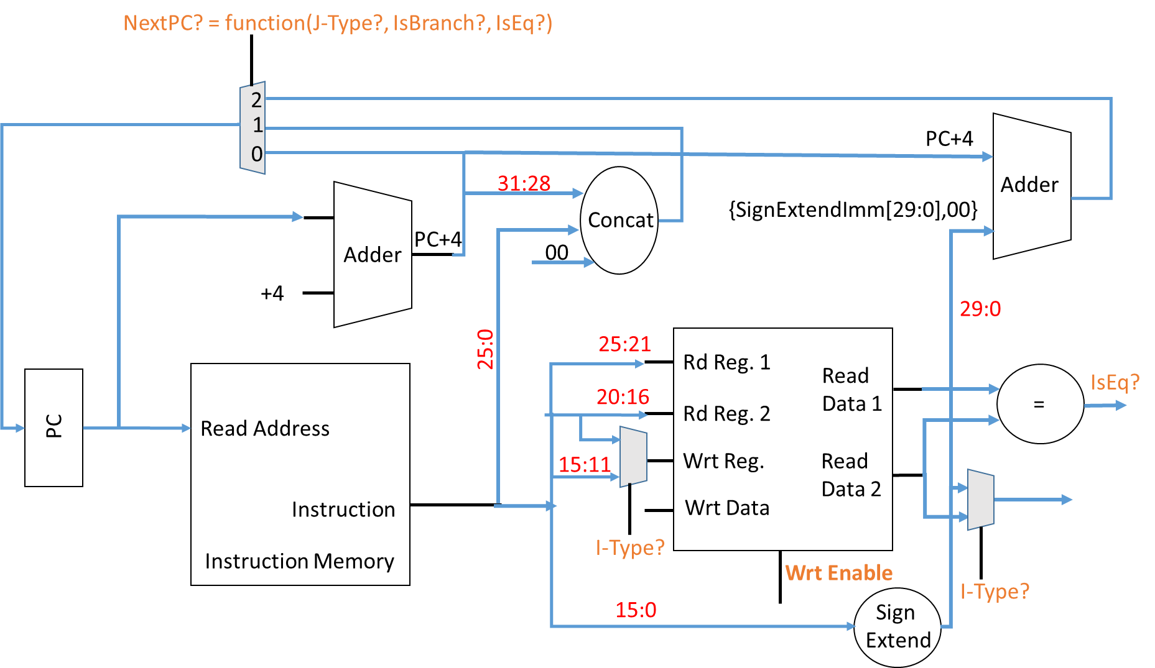
If (IsBranch? && isEQ?)
NextPC? = 2
else if (J-Type?)
NextPC? = 1
else
NextPC? = 0
In-Class Problem 3:
Write pseudo-code for NextPC?

Slide 17
Synchronous Implementation
Most digital circuits make use of a periodic “clock”
Flip-flop: basic component used in synchronous designs
Looks at In at every positive clock edge and sets Out = In
Holds the value of Out steady till next positive edge
Positive Edge
In
Out
FLIP-FLOP
Clock Period (seconds)
clock

Slide 18
Flip-flop Operation
Clock
In
Out
FLIP-FLOP
In
1
clock
Out
0
0
0

Slide 19
Synchronous Counter
32 bits
State is only updated at every positive clock edge
In
Out
Adder
32 bits
FLIP-FLOP
+1
clock
Clock
0
1
2
3
4
5

Slide 20
Synchronous Single-Cycle MIPS
Goal: A new instruction is fetched and executed in every clock period
For now let’s focus on the instruction fetch part of R-type instructions
PC register implemented using flip-flops
Adder
Adder
+4
+4
FLIP-FLOP
(PC)
PC
Read Address
Read Address
Instruction
Instruction
Instruction Memory
CLOCK
Instruction Memory

Slide 21
Fetch Stage Operation
Clock
PC register implemented using flip-flops
Adder
+4
PC
0
4
8
nextPC
4
8
12
nextPC
FLIP-FLOP
(PC)
Read Address
PC
Inst
Instruction
In every clock cycle, the PC is updated and the corresponding instruction is fetched from instruction memory
CLOCK
Instruction Memory

Slide 22
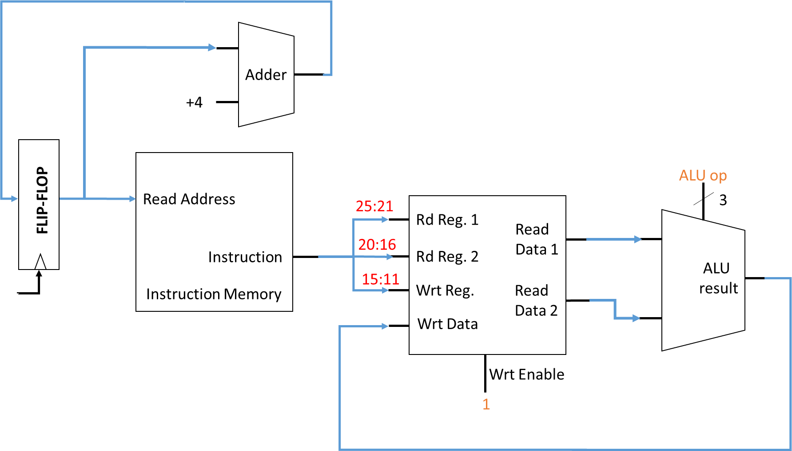
Execute/Write-Back Stage Operation
Goal: all updates to architectural state should occur at positive clock edges
PC (already done!)
Register file
Data memory (not relevant for R-type instructions)

Slide 23
0
00000
3
00001
12
00010
4
Adder
.
00011
+4
1
.
Decoder
9
11111
Wrt Enable
4
ALU op
0
add $1, $2, $3
FLIP-FLOP
(PC)
Read Address
3
25:21
Rd Reg. 1
Read
Data 1
3
20:16
Instruction
Rd Reg. 2
15
ALU
result
15:11
12
Instruction Memory
Wrt Reg.
Read
Data 2
Wrt Data
What’s wrong?
15
FLIP-FLOP

Slide 24

0
00000
3
00001
12
00010
4
Adder
.
00011
1
15
+4
1
.
Decoder
9
11111
Wrt Enable
4
add $0, $1, $2
1
ALU op
0
add $1, $2, $3
FLIP-FLOP
(PC)
Read Address
$0
3
$1
Rd Reg. 1
Read
Data 1
3
$1
$2
Instruction
Rd Reg. 2
15
$3
ALU
result
$2
$3
Instruction Memory
Wrt Reg.
Read
Data 2
12
Wrt Data
15
FLIP-FLOP

Slide 25
0
00000
3
00001
12
00010
4
Adder
.
00011
1
15
+4
1
.
Decoder
9
11111
Wrt Enable
4
add $3, $1, $2
1
ALU op
0
add $1, $2, $3
FLIP-FLOP
(PC)
Read Address
$3
3
$1
Rd Reg. 1
15
Read
Data 1
3
$1
$2
Instruction
Rd Reg. 2
15
$3
ALU
result
$2
$3
Instruction Memory
Wrt Reg.
Read
Data 2
12
Wrt Data
Simultaneous R/W request to the same register -> Write before Read
15
FLIP-FLOP

Slide 26
Synchronous Counter Clock Period
32 bits
Assume each addition takes 1 ns. What is the minimum clock period?
6
In
Out
Adder
32 bits
5
+1
FLIP-FLOP
clock
5
1 ns
6
Clock
Period > 1ns

Slide 27
What is the clock period of the single cycle MIPS?
Assume each block has a delay of 1 ns
1 ns
Adder
2 ns
+4
Decoder
0 ns
Wrt Enable
ALU op
FLIP-FLOP
(PC)
Read Address
3
0 ns
Rd Reg. 1
Read
Data 1
2 ns
Instruction
Rd Reg. 2
3 ns
1 ns
0 ns
ALU
result
Instruction Memory
Wrt Reg.
Read
Data 2
2 ns
Wrt Data
Minimum Period = 3 ns
0 ns
FLIP-FLOP

Slide 28
CPU Performance Metrics
Instructions Per Cycle (IPC)
IPC of the single-cycle MIPS: 1
Can IPC be greater than 1? Yes: super-scalar processors
Let’s say CPU1 and CPU2 have the same IPC, but CPU1 runs at a faster clock frequency (small clock period). Which is better?
Instructions Per Second (IPS)
(Instructions/Cycles x Cycles/Second) = (Instructions/Cycles x Clock Frequency)
Single-Cycle MIPS IPS = 1 Inst/Cycle x (1 / 3 ns) = 0.33 Giga Instructions/second

Slide 29
Improving Throughput: Pipelining
Flip-Flop
Flip-Flop
Module 1
Module 2
Module 3
Module 4
t1
t2
t3
t4
CLK
CLK
Throughput = 1/(t1+t2+t3+t4)
Flip-Flop
Flip-Flop
Flip-Flop
Flip-Flop
Flip-Flop
Module 1
Module 2
Module 3
Module 4
t1
CLK
t2
CLK
t3
CLK
t4
CLK
CLK
Throughput = ?

Slide 30
Pipeline Operation
Clock Period = max(t1,t2,t3,t4)
Flip-Flop
Flip-Flop
Flip-Flop
Flip-Flop
Flip-Flop
Module 1
Module 2
Module 3
Module 4
t1
CLK
t2
CLK
t3
CLK
t4
CLK
CLK
In steady state, each module processes data in parallel -> Throughput = 1 / max(t1,t2,t3,t4)

Slide 31
Pipelining the Single-Cycle R-Type MIPS
Basic steps in executing an R-type instruction
Instruction fetch (IF)
Instruction Decode/Register File Read (ID/RF)
Execute in ALU (EX)
Write-back Result to RF (WB)
Flip-Flop
ID/RF
(Decoder, RF)
Flip-Flop
EX
(ALU)
Flip-Flop
Flip-Flop
Flip-Flop
IF
(PC, Imem)
WB
(RF)
CLK
CLK
CLK
CLK
CLK
For now we will ignore ld/st instructions!

Slide 32
Adder
Wrt Enable
Wrt Enable
+4
Decoder
ALU op
ALU op
FLIP-FLOP
(PC)
Wrt Enable
Read Address
FLIP-FLOP
3
FLIP-FLOP
Rd Reg. 1
Read
Data 1
WB
FLIP-FLOP
Instruction
Rd Reg. 2
ALU
result
Instruction Memory
Wrt Reg.
Read
Data 2
15:11
Wrt Data
IF
ID/RF
EX

Slide 33
1 ns
Adder
0 ns
1 ns
Wrt Enable
Wrt Enable
+4
Decoder
1 ns
0 ns
0 ns
ALU op
ALU op
FLIP-FLOP
(PC)
0 ns
Wrt Enable
Read Address
FLIP-FLOP
3
FLIP-FLOP
0 ns
1 ns
Rd Reg. 1
FLIP-FLOP
Read
Data 1
1 ns
WB
Instruction
Rd Reg. 2
ALU
result
1 ns
Instruction Memory
Wrt Reg.
Read
Data 2
15:11
Wrt Data
0 ns
IF
ID/RF
EX
Clock Period: 1 ns

Slide 34
Pipelined Control Signals
Adder
Wrt Enable
Wrt Enable
+4
Decoder
ALU op
ALU op
FLIP-FLOP
(PC)
Wrt Enable
Read Address
FLIP-FLOP
3
FLIP-FLOP
Rd Reg. 1
Read
Data 1
WB
FLIP-FLOP
Instruction
Rd Reg. 2
ALU
result
Instruction Memory
Wrt Reg.
Read
Data 2
15:11
Wrt Data
IF
ID/RF
EX

Slide 35
Adder
1
1
Wrt Enable
Wrt Enable
+4
Decoder
SUB
ADD
AND
SUB
ALU op
ADD
ALU op
FLIP-FLOP
(PC)
1
Wrt Enable
add $10, $11, $12
add $1, $2, $3
3
Read Address
and $7, $8, $9
0: add $1, $2, $3
4: sub $4, $5, $6
8: and $7, $8, $9
12: add $10, $11, $12
sub $4, $5, $6
add $1, $2, $3
FLIP-FLOP
$7
$4
sub $4, $5, $6
FLIP-FLOP
$1
0
and $7, $8, $9
4
8
12
Rd Reg. 1
WB
Read
Data 1
R[$1]
FLIP-FLOP
$5
R[$4]
$2
$8
Instruction
Rd Reg. 2
ALU
result
Instruction Memory
Wrt Reg.
Read
Data 2
R[$5]
R[$2]
Wrt Data
$3
IF
ID/RF
$3
EX
$3
$6
$9
$6
R[$1]+R[$2]

